Slide 1
First Class of Python

Slide 2
Getting to know each other
Are you familiar with Programming?
Which programming languages (Java, C, C++, Python, JavaScript, etc) do you know?
Do you know HTML?
How much would you rate yourself in Python out of 10?

Slide 3
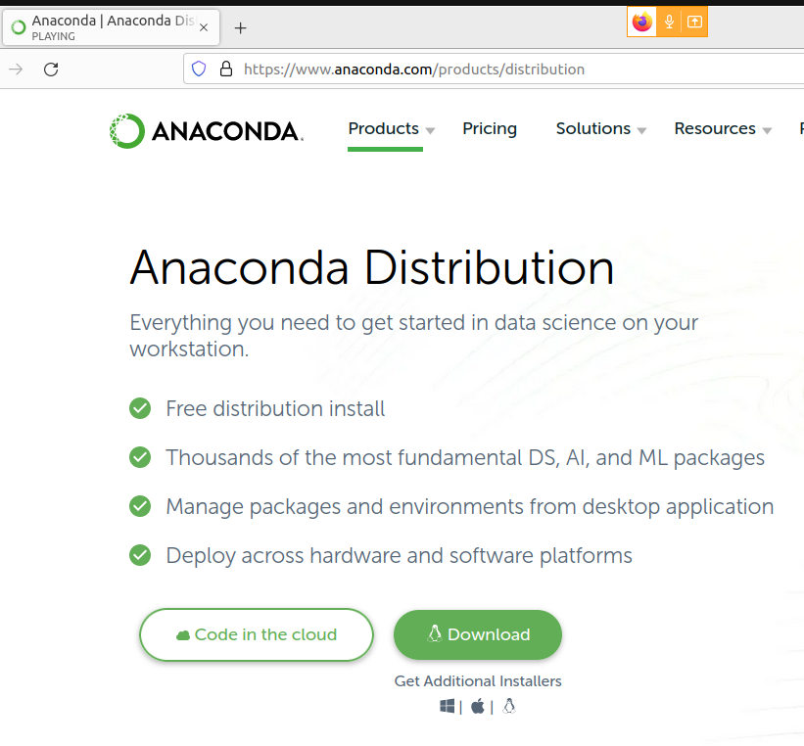
Where to run our Python Code?
URL: https://anaconda.org/

Slide 4
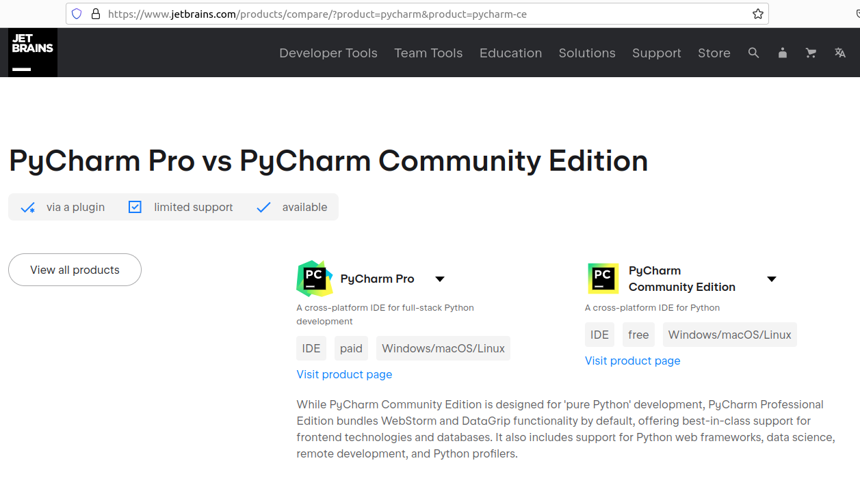
PyCharm

Slide 5
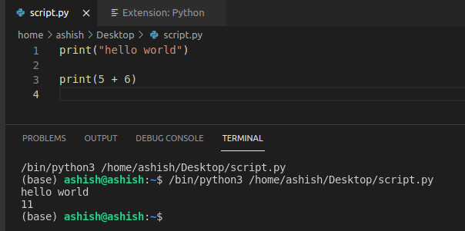
In Visual Studio Code
URL: https://code.visualstudio.com/download

